Slide 1
PoC Projects
Michael McCool, Intel
Jennifer Lin, GovTech Singapore
David Ezell, Conexxus

Slide 2
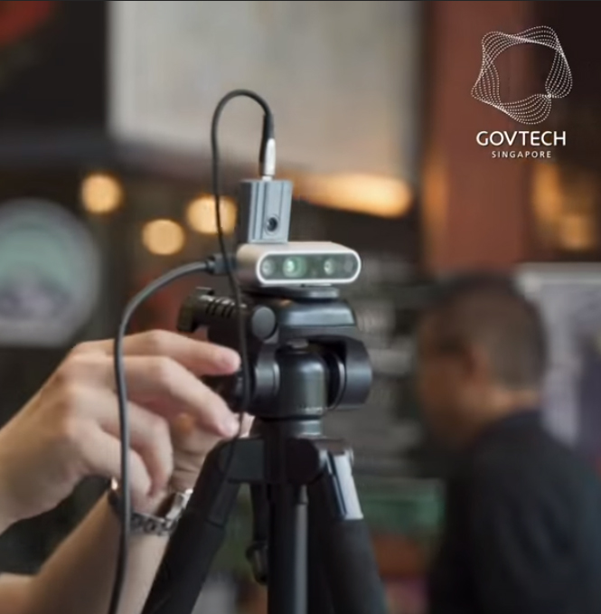
Smart City: GovTech Singapore
Person Density/Fever Mapping
Use of AI and thermal cameras for health monitoring; pandemic management
City Dashboard
Collection and visualization of data to support decision making
Transportation
Fleet management, mapping, routing; both logistics (deliveries) and people
Robotics
Security patrols, parks, sensor placement, mapping, coordinated land and air swarms
Geolocation
Component of most of the other use cases; both static and dynamic (portable)

Slide 3
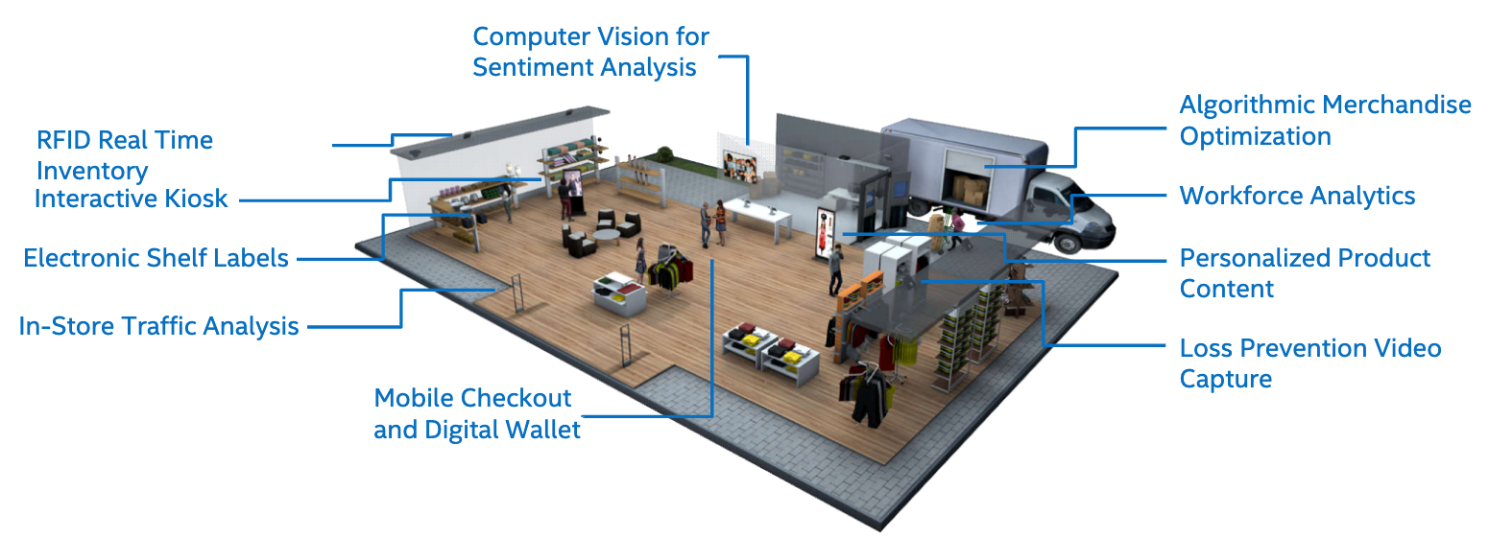
Retail: Intel ORI/EdgeX/Conexxus

Slide 4


Retail PoC Collaboration
Intel’s Open Retail Initiative (ORI)
EdgeX Foundry
Conexxus
W3C Web of Things

Slide 5

Retail Scenario: Buying an Ice Cream
Camera captures image and sensor detects freezer door opening
Data analytics identifies person and product
Camera
Person identification
Alert based on location and behavior
To counter:
To door:
Associate facing alert: Customer waiting
Associate facing alert: Zone violation
Person tracking
Freezer Door Sensor
Product identification
Customer facing alert: Price display
Customer facing alert: Door “reminder” display
2020-06-23
W3C Web of Things (WoT) WG/IG
5

Slide 6

High Level Diagram of Implementation
Person Identification
Product Identification
Customer Tracking
Zone Controls
Analytics
Middleware: EdgeX
Camera
Freezer Door
Digital Signage
PoS
Wearables
Store Associate Messaging²
Devices
Applications that publish and/or subscribe to data
Devices that display actionable alerts
2020-06-23
W3C Web of Things (WoT) WG/IG
6

Slide 7
Adaptation: Replace Real with Virtual Device
Person Identification
Product Identification
Customer Tracking
Zone Controls
Freezer Door
Analytics
Middleware: EdgeX
Camera
Digital Signage
PoS
Wearables
Store Associate Messaging²
Devices
Applications that publish and/or subscribe to data
Devices that display actionable alerts
2020-06-23
W3C Web of Things (WoT) WG/IG
7

Slide 8
Showcase Need for End-User Programming
Adaptation to Available Devices
Rapid/Easy Development
In order to consolidate services, devices need to be shared
Services developed in a “siloed” fashion assuming exclusive access to devices cannot be consolidated
Services may have to adapt to (or be adapted to) substitute devices
Adapting services to a given environment may require some “end-user programming”
This should be as simple as possible
Tools should support device and service connection, substitution, and sharing

Slide 9
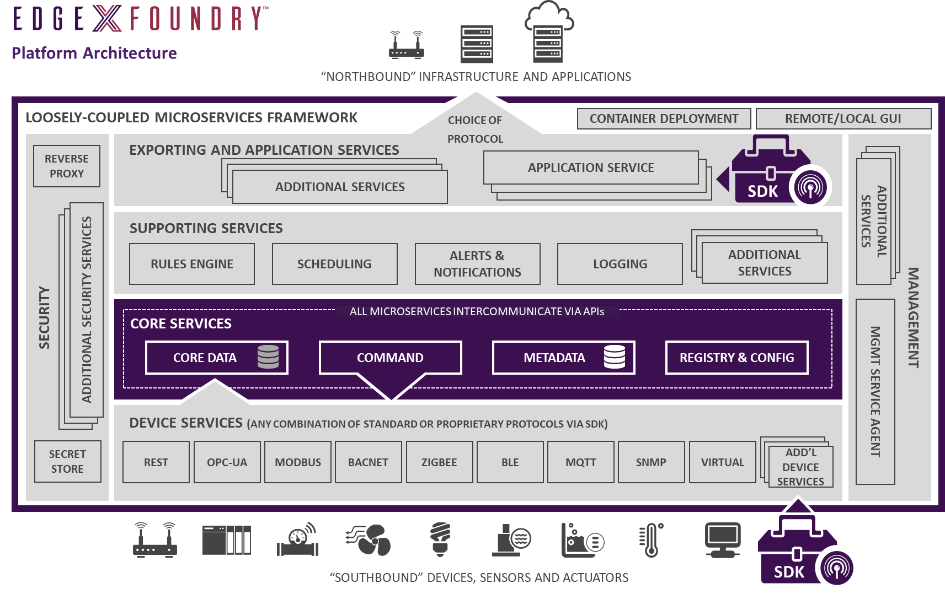
WoT Scripts/Node-RED
WoT TDs
9

Slide 10
Planned WoT/EdgeX Integration
Generate WoT Thing Description metadata for all EdgeX Device services
Including semantic tagging using One Data Model
Generate WoT Thing Description metadata for select EdgeX Analytics services
Computer vision services
Prototype a Thing Directory service supporting semantic search
To run in parallel with existing EdgeX metadata service
Existing EdgeX discovery process would act as “Introduction” layer – WoT Discovery prototype
Support Rapid Orchestration Development
Using WoT Scripting API and node-wot
Using node-gen to generate Node-RED modules
Stand up Retail use case examples that integrate IoT and Analytics:
Loss detection video analytics triggered by an IoT door sensor
Digital shelf signage/RFID and weight-based inventory control/item identification
Customized marketing content based on video analytics
Notes:
What “virtual sensors” can replace “real sensors”?
Door opening -> replaces door switch
Presence detection -> replaces PIR sensor
Product recognition -> replaces RFID or barcode reader
What other vision services don’t correspond to existing devices?
Face detection
Cash tracking
Can I translate events back DOWN to the low-level protocol to emulate existing devices?
Emulate an RFID reader with a computer vision service
What scenarios…
Replace existing functions?
Improve service?

Slide 11
Other PoCs and Deployments

